Slide 1
IMS2024
Interactive Forum (IF) Poster Guidelines

Slide 2
Instructions on IF Poster Preparation
Your Interactive Forum (IF) presentation(s) at IMS2024 will consist of an electronic “poster” on a horizontal monitor, using the provided computer.
A single, electronic poster discussing the participant’s research in broad strokes. This poster should include a penta chart, which covers the primary motivations, insights, and results of the project.
Participants are responsible for preparing and bringing their poster to their specific IF session on a USB drive.
IMPORTANT NOTE: IF Presenters MUST check in with the Session Chair(s) at the Check-In Area at least 15 minutes prior to the start of their session.

Slide 3
Penta Chart
A penta chart provides a concise summary of a paper/project by displaying principle information needed to understand the project in a clear and easy-to-read manner.
A penta chart example is provided on Slide 4. The entire poster should be prepared in landscape 16 x 9 format in PowerPoint or PDF format.
The penta chart is divided into five sections:
  Status quo – Background and motivation, current state-of-the-art. What problem are you trying to solve, or what improvement are you trying to make?
  New insights – Describe what’s new about your approach. Why should people care?
  Description - Main achievements, concept, how it works, assumptions and weaknesses.
  Quantitative impacts – What were your results, and how do these compare with existing technologies/techniques?
  Proposed concept goal - Final product of your work. Where is this leading, and what are the next steps?

Slide 4
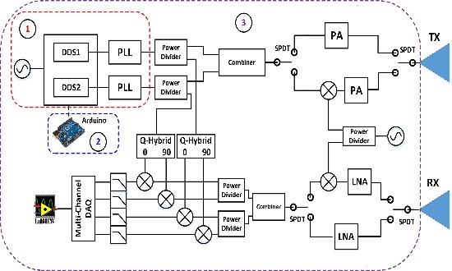
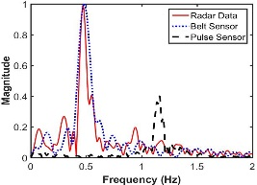
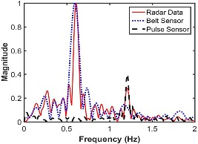
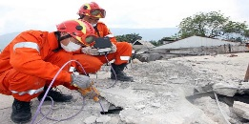
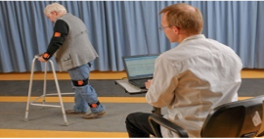
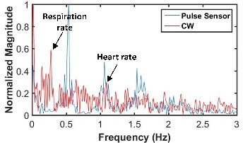
Development of a Reconfigurable Low Cost
Multi-Mode Radar System for Contactless Vital Signs Detection
F. Quaiyum, L. Ren, S. Nahar, F. Foroughian, A. E. Fathy
Contactless Vital Signs Monitoring
STATUS QUO
QUANTITATIVE IMPACT
Lower Band (2-4 GHz) SFCW mode. Lacks sensitivity, useful in through wall applications
Higher Band (7-9 GHz) SFCW mode for higher sensitivity
A hybrid approach required: UWB for short range heart rate detection and imaging, CW for long range vital signs
Traditional hybrid systems bulky, expensive and difficult to control
EXAMPLE
The transceiver is mainly composed of three parts:
Waveform Generator
Two channel DDS board where each channel can be independently configured
Capable of providing either a CW signal or SFCW signal
Microcontroller
Configures the waveform generator to perform in CW or in SFCW mode
Controls the SPDT switches enabling center frequency reconfiguration
Microwave Front End
Consisting of the Amplifiers, Mixers, Power Dividers and Antennas
CW mode for long range vital signs detection
DESCRIPTION
CW Radar
+
UWB Radar
Hybrid Radar
Multi-Mode Radar System featuring:
Minimal Size, Weight, and Power (SWAP) capable of high-resolution, and high-quality imaging
Low cost due to the sharing of components
Totally controlled by a micro-controller
High sensitivity high frequency operation without the requirement of sophisticated PLL/DDS board
Multi-Mode Operation with Reconfigurability
UWB Mode
Short-range SAR operation
Center frequency shifting for higher sensitivity
CW Mode Operation
Long range remote triage
Interferometry functionality using dual CW operation
PROPOSED CONCEPT GOALS
NEW INSIGHTS

